Slide 1

Quick Cart App. Spray paint the Eiffel tower
Created by: Strange Energy

Slide 2

Let’s get started!

Slide 3

About Quick Cart
The Quick Cart application was created to aid users in their shopping experience, allowing users to accomplish two main tasks:
Locate items while shopping in store
Order items through the app and pick up an already packed and ready bag in store.
The application accomplishes this through the use of MySQL and SQLite databases.

Slide 4
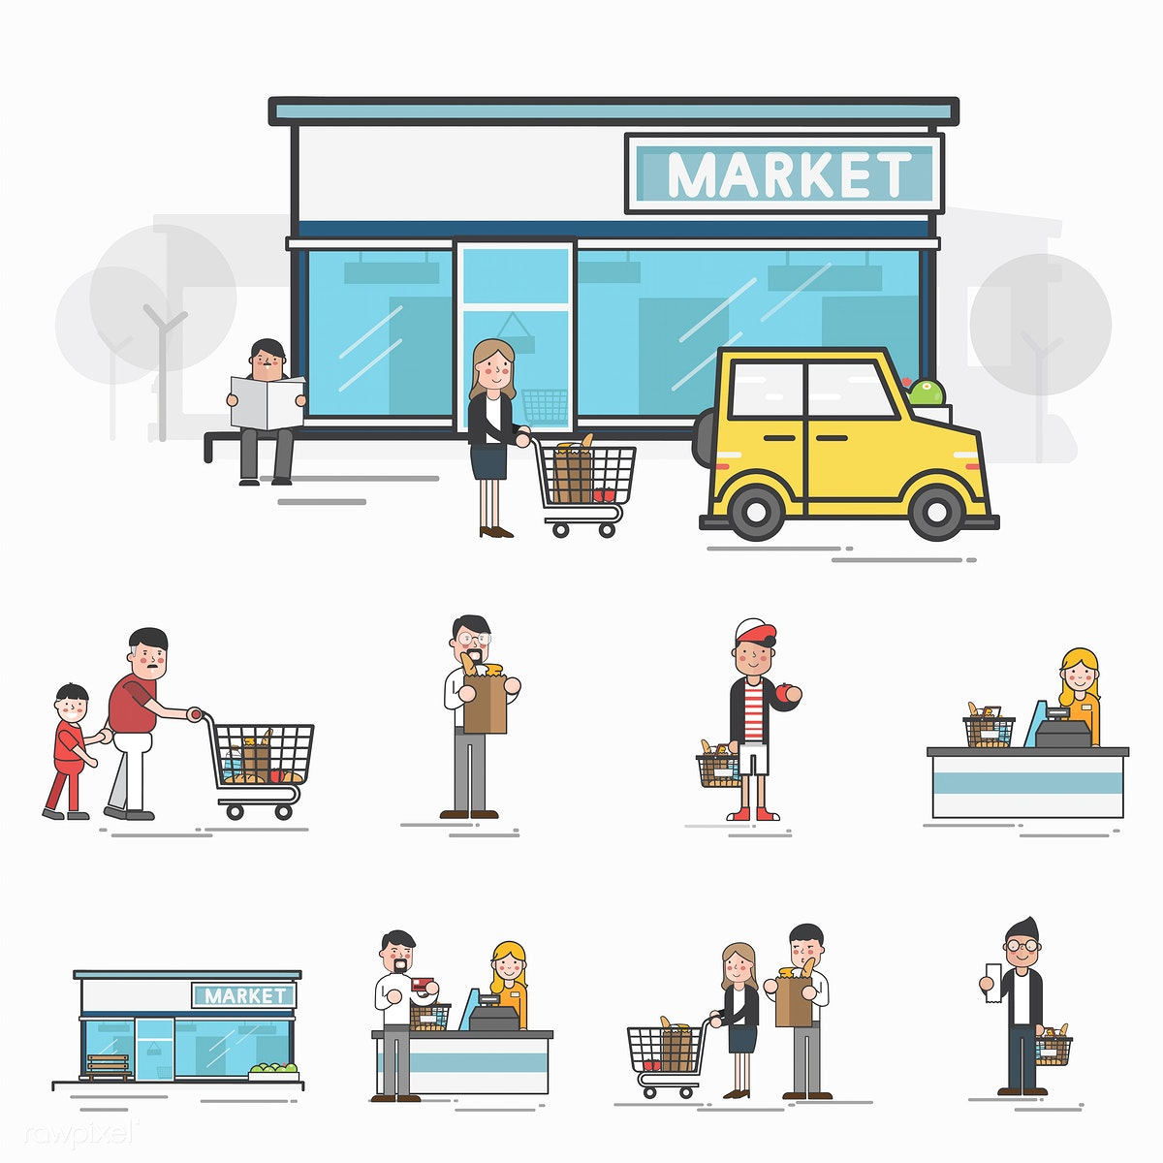
Key Features
Login/Sign up
Allows new users to create an account and sign in to the application.
Database
Contains user and item information.
Community(Powered by Flask)
Will be discussed Friday

Slide 5


Key Features Continued
Locate
Allows in store users to search for items which the application then displays the items location.

Slide 6

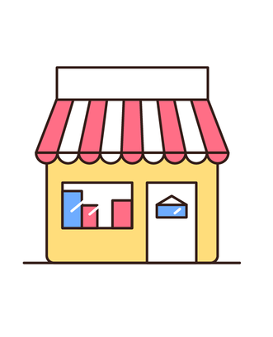
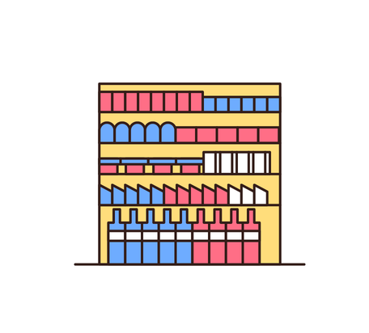
Key Features Continued
Shopping
Allows users to shop from home by selecting items and adding them to their cart. Upon checkout a QR code is generated which the user will present upon in store collection.

Slide 7
Future Implementations
An application is never truly complete!
In app payment
GPS to nearest Quick Cart powered store
To support delivery
Coupon implementation
Time Specification

Slide 8
Let’s see a LIVE DEMO!

Slide 9

Thank You!
Any Questions?

